Slide 1
MJCAS - Blog
-Peak Performers

Slide 2
Peak Performers
S.no | Name | ID
1. | S.Suvathi | 2122j1478
2. | Sangamithirai M | 2122k2680
3. | M.Selvapriya | 2122k2681
4. | I.Merline Sugirtha | 2126j0392
5. | S.Sasimary | 2122j1475
6. | G.Kousalya | 2122k2669
7. | S.Sindhuja | 2122k2683
8. | Snehalata Nayak | 2122k2684

Slide 3
Introduction
Blog or weblog
Online diary
WIIFM
Word choice
Presentation
Don’t mislead people

Slide 4
MJCAS-Blog
Michael job college of arts & science for women
History & background
Mission & vision
Students life

Slide 5
Coding languages used | Software used
Html Css JavaScript | Notepad Visual Studio

Slide 6
Time Line

Slide 7
What We Learnt?
How to create blog
More about MJCAS
More tags
Cope up with team
Communicating with others

Slide 8

Launch Page

Slide 9
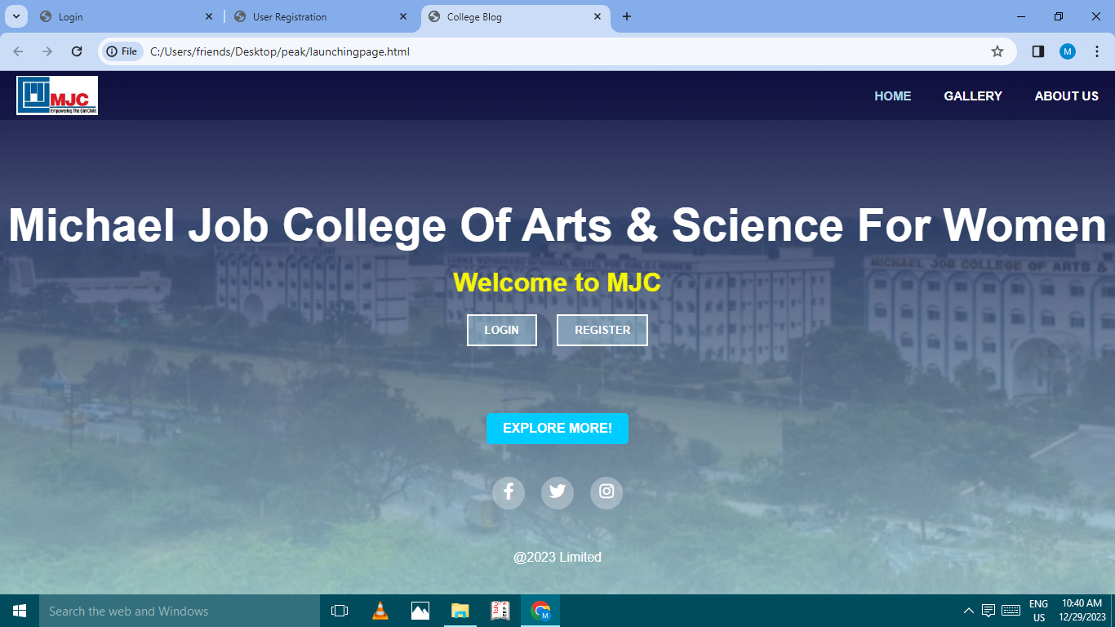
Welcome page

Slide 10
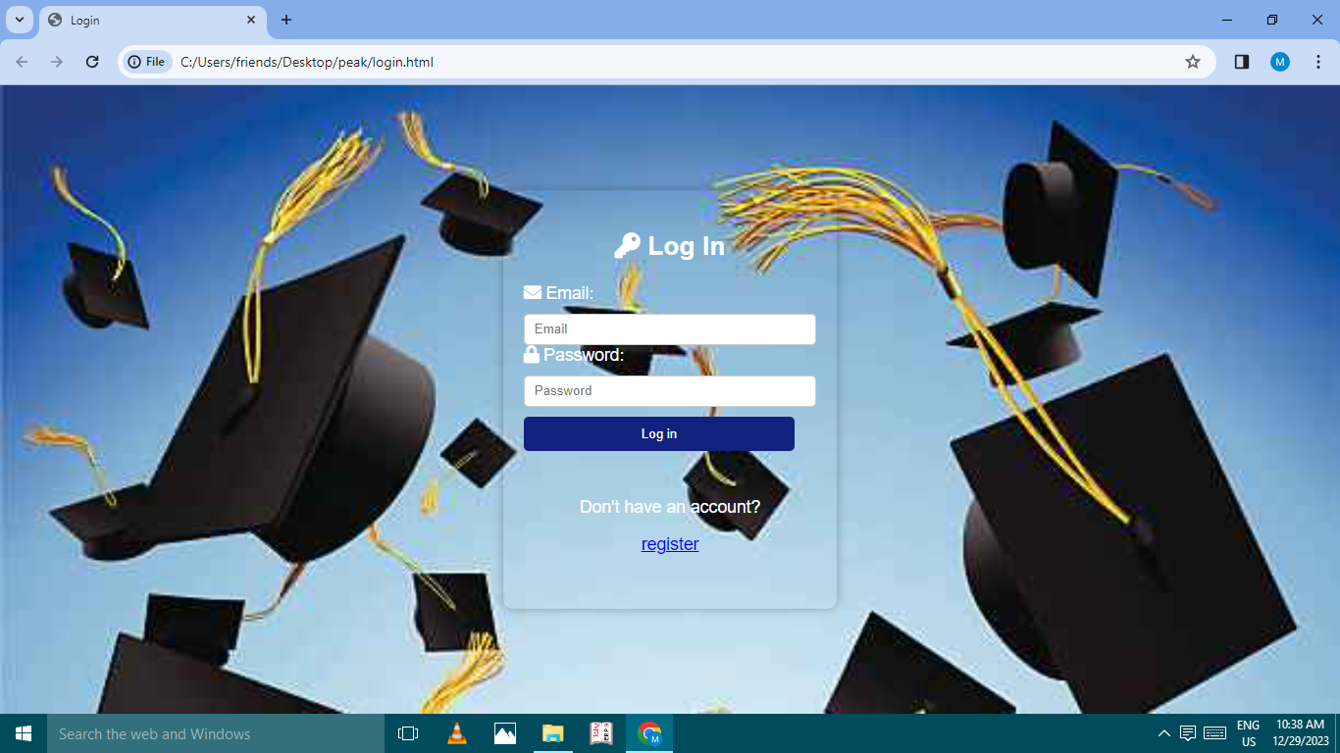
Log In Page

Slide 11
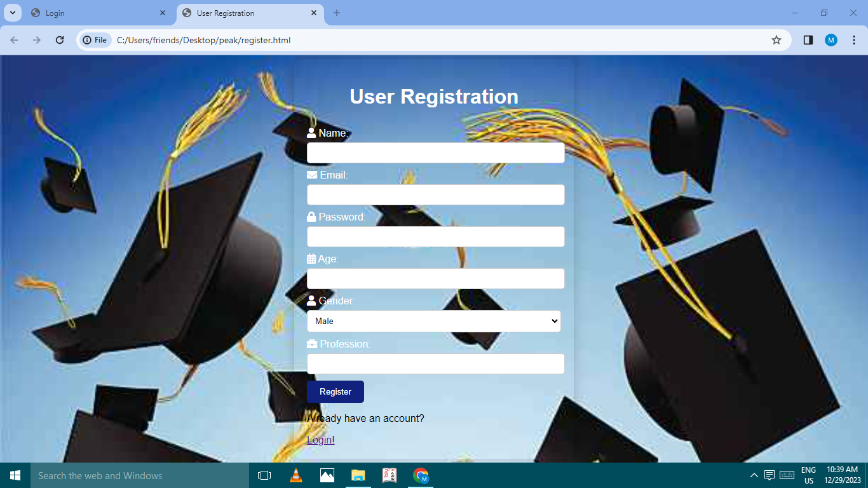
Register Page

Slide 12
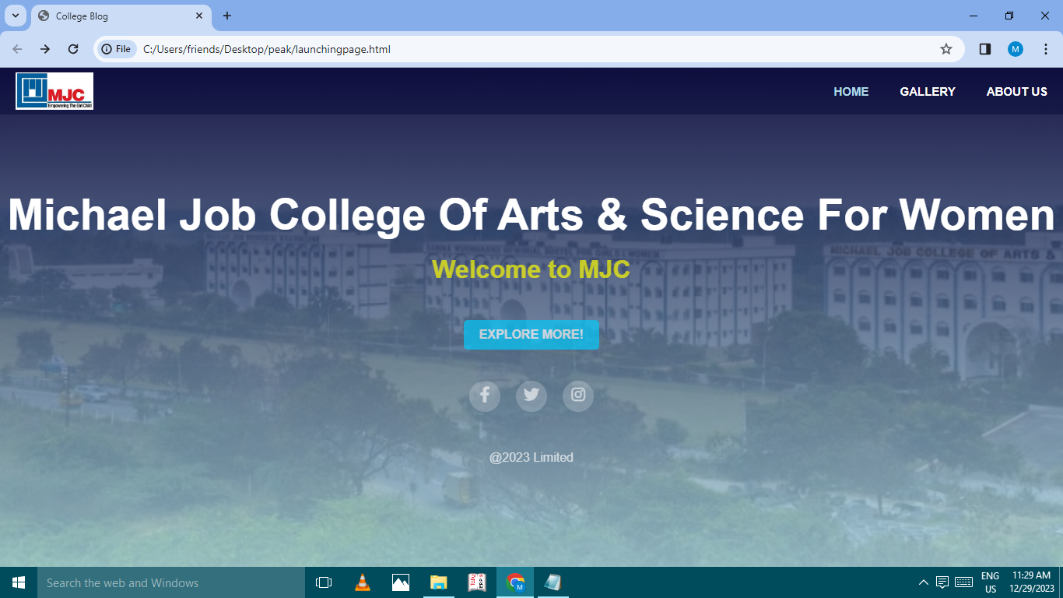
Home Page

Slide 13
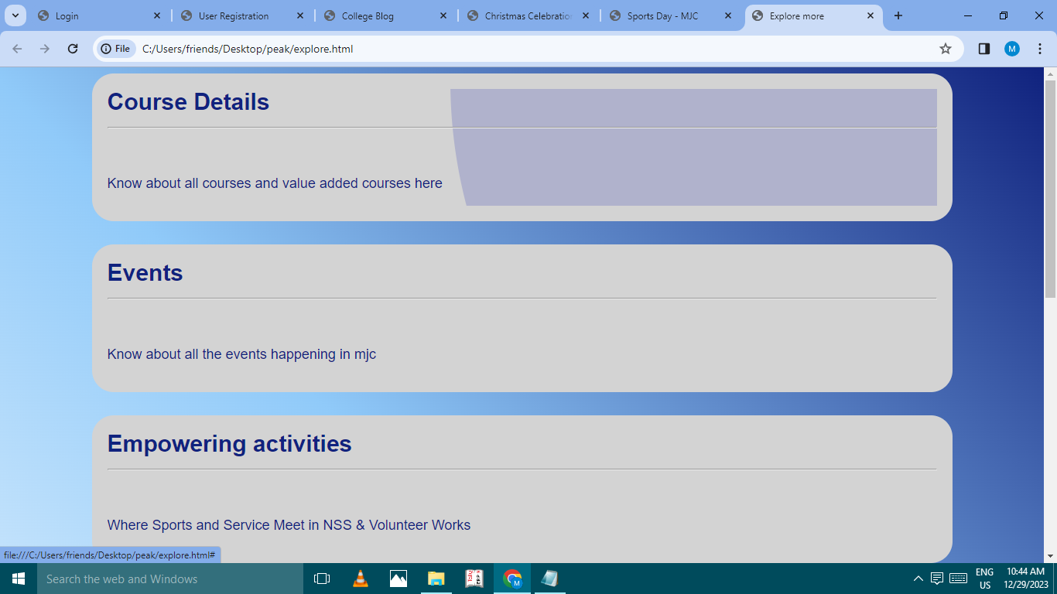
Explore More Page

Slide 14
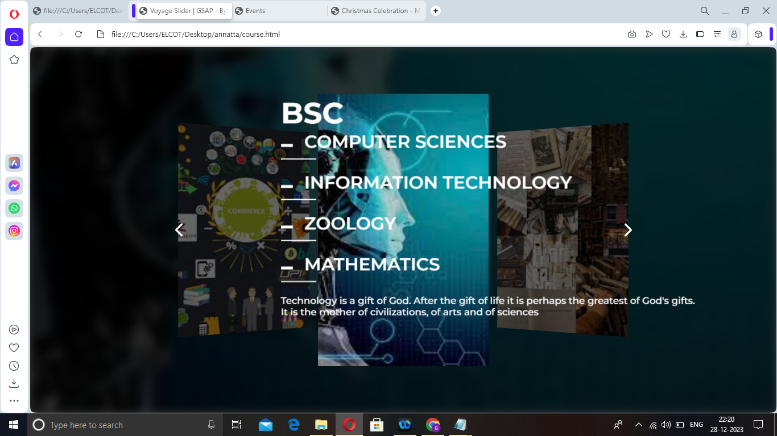
Courses Page
Youtube.com

Slide 15
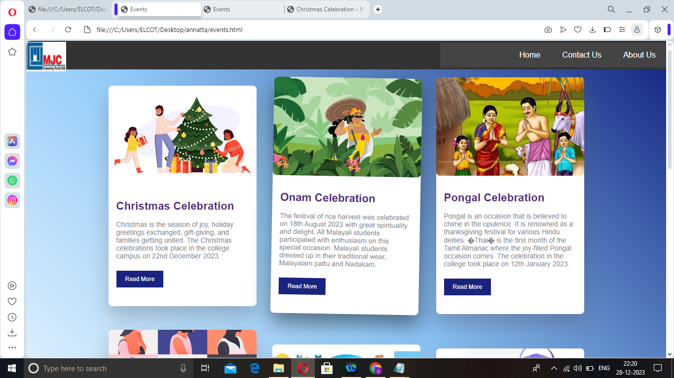
Events Page

Slide 16
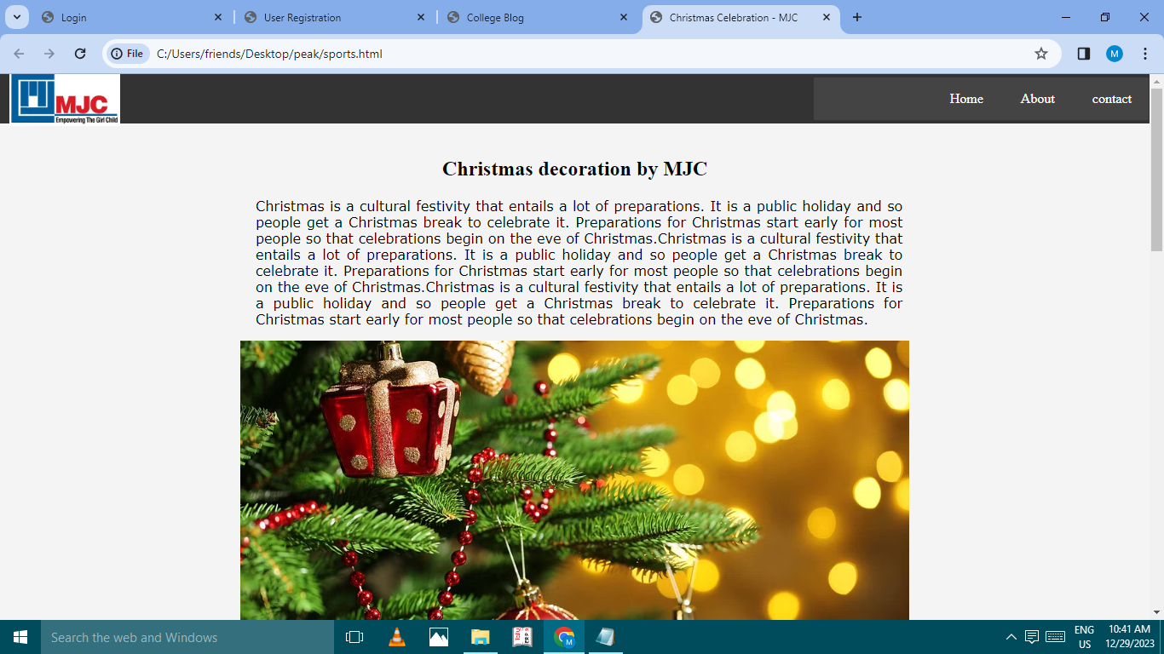
Christmas Page

Slide 17
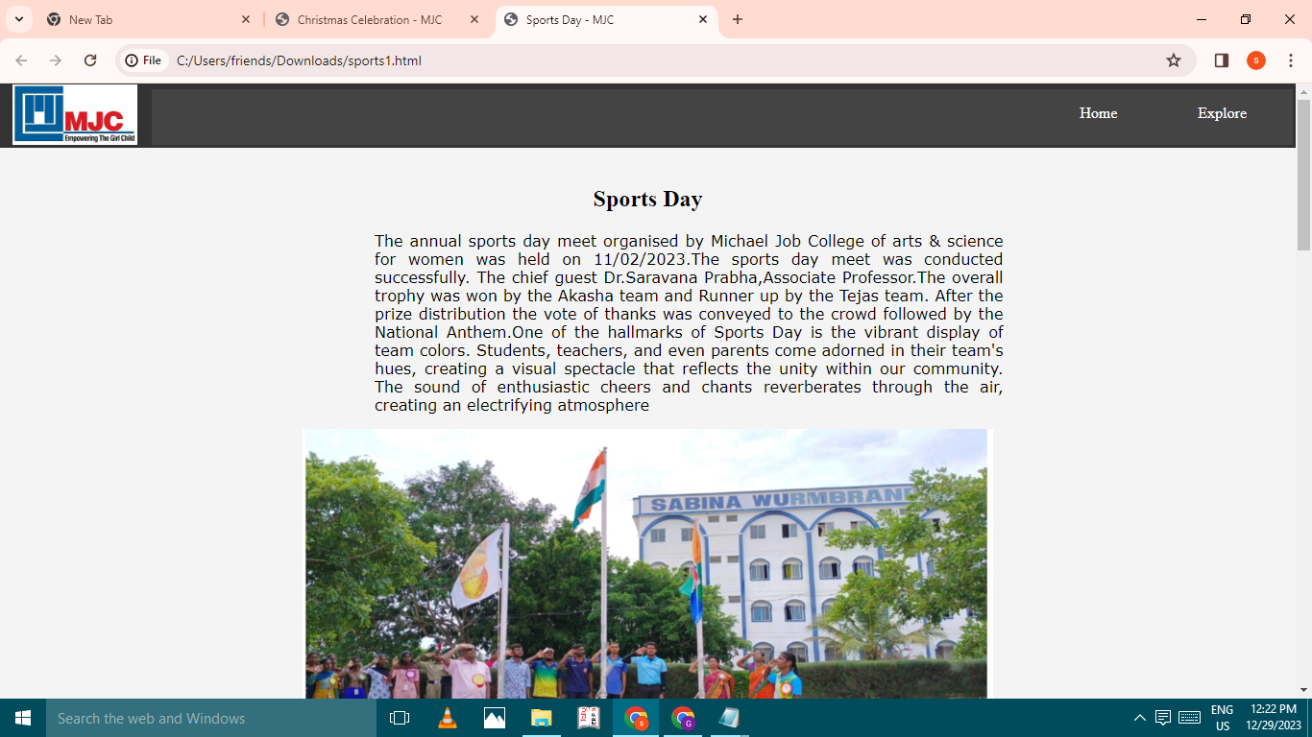
Sports Page

Slide 18
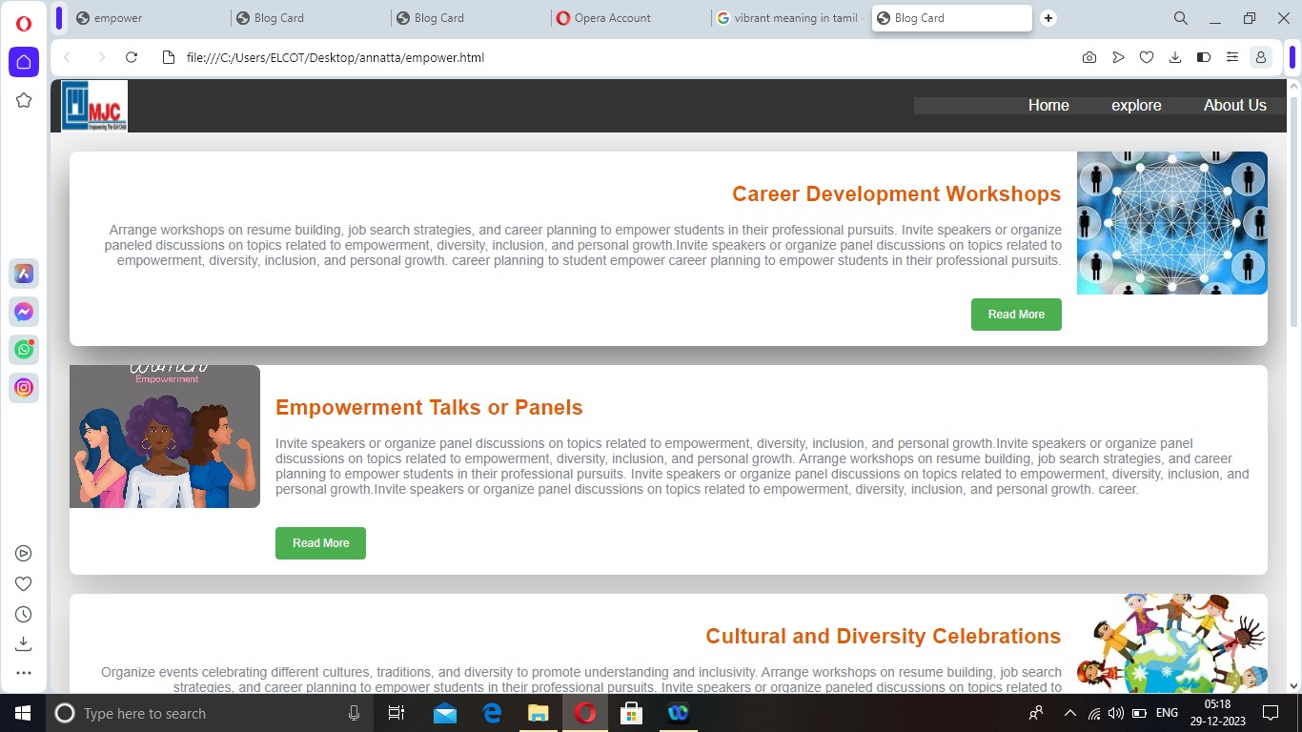
Empowering page

Slide 19
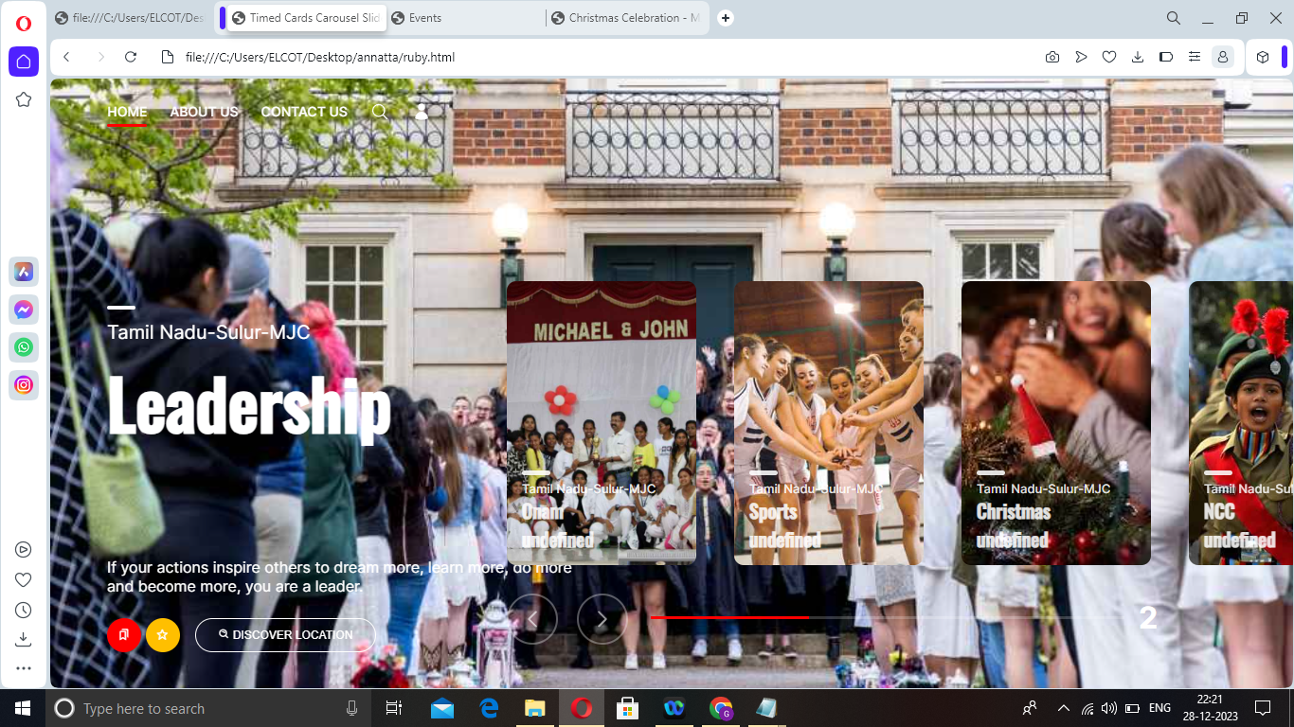
Capturing Moments Page
Youtube.com

Slide 20
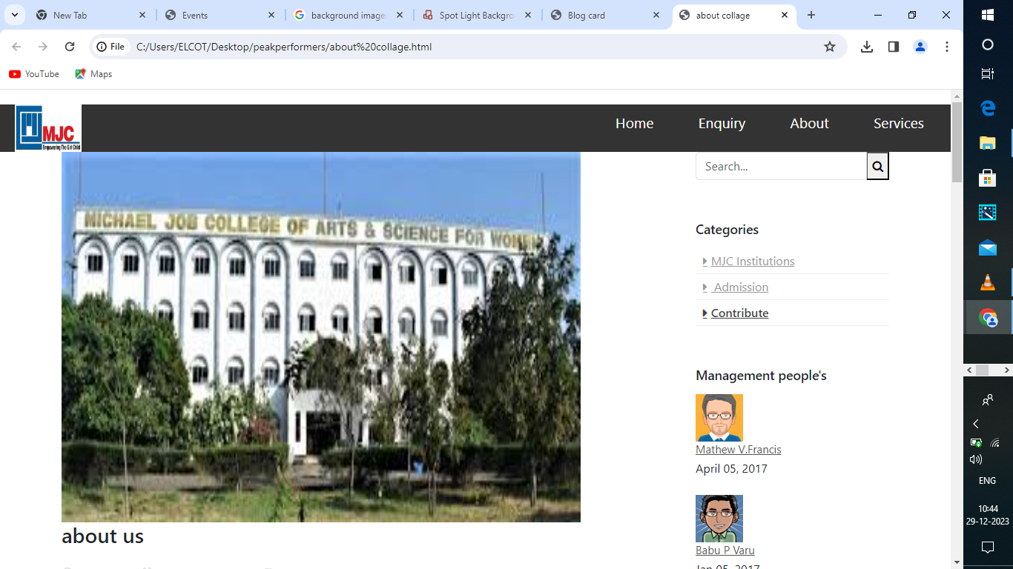
About Us Page

Slide 21
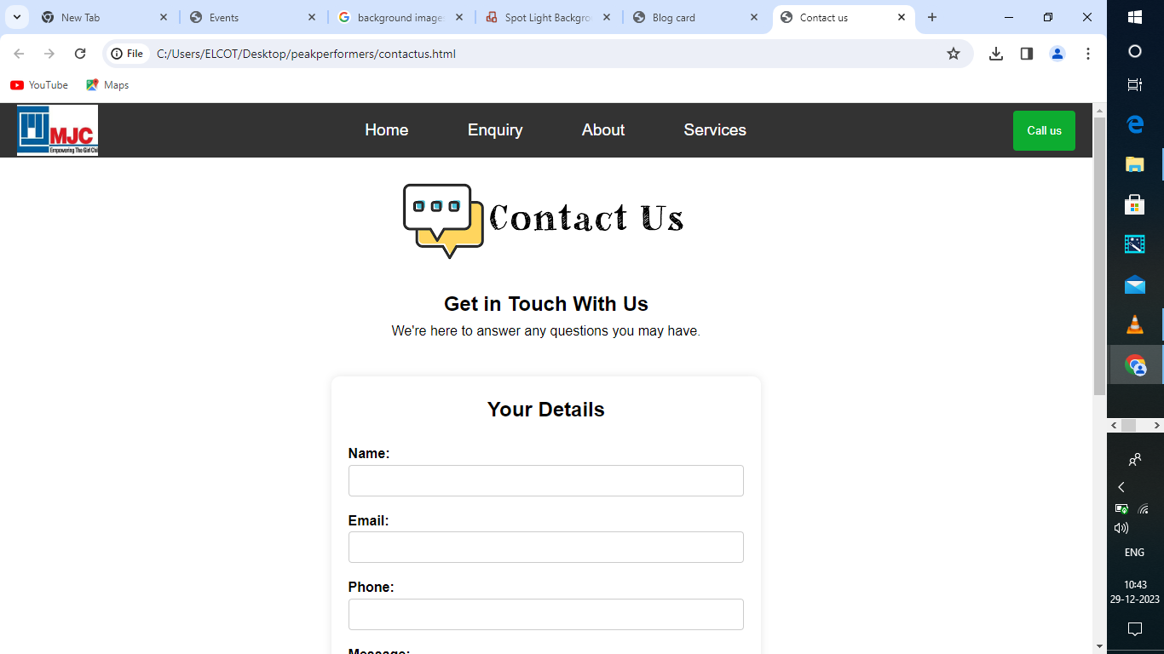
Contact Us Page

Slide 22
Unique
Creative writing
Information
Sharing opinion
Entertaining
Regular updates

Slide 23
Advantages
Co- curricular activities
Community engagement
Campus Facilities
Library and Resource center
Sports

Slide 24
Disadvantage
Technical problems
Time management
Need maintenance
Write regularly.
Network issues

Slide 25
Conclusion
Lessons learnt
College doesn’t mold only academic power
College popular

Slide 26
Q & A

Slide 27
Thank You!

